Slide 1
NOTE : Every student should log into our website to enter the webinar. Should not get the link from other students.

Slide 2
Interest Calculations
Simple Interest
Compound Interest

Slide 3
There are two ways in which the interest is calculated.
1) Simple Interest :
It is calculated on the basis of a basic amount borrowed for the entire period at a particular rate of interest. The amount borrowed is the principal for the entire period of borrowing.
2) Compound Interest:
The interest of the previous years are added to the principal for the calculation of the compound interest.

Slide 4
Simple Interest = P*N*R / 100
Where
P- Principal
N- Number of Years
R- Rate of Interest
Note : The interest gained in Simple interest will always remain the same for every year.
Example : 1000 RS @ the rate of 10% per annum
1 st year interest will be 100
2 Nd year interest will also be same 100
So S1 = S2 =……………= Sn years

Slide 5
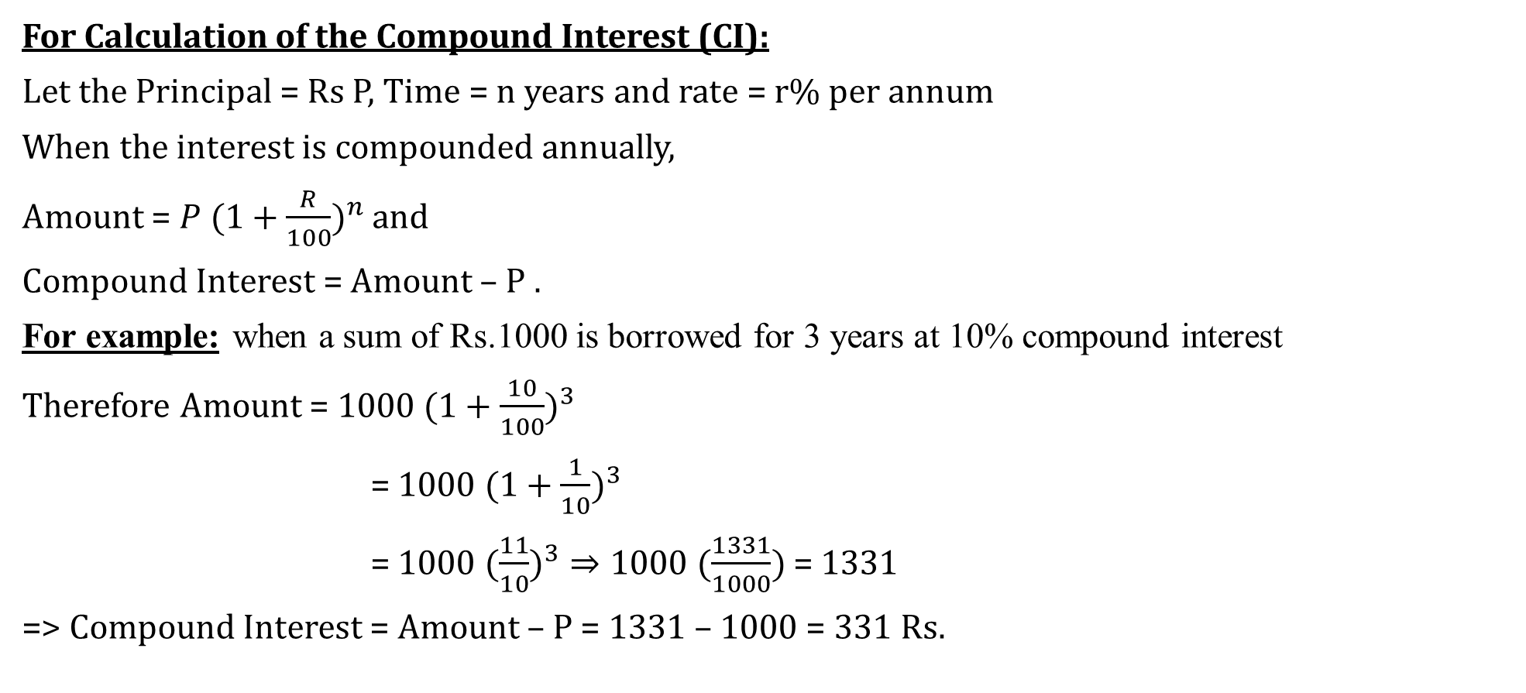
For Calculation of the Compound Interest (CI):
Let the Principal = Rs P, Time = n years and rate = r% per annum
When the interest is compounded annually,
Amount = ${P (1+\frac{R}{100})}^{n}$ and
Compound Interest = Amount – P .
For example: when a sum of Rs.1000 is borrowed for 3 years at 10% compound interest
Therefore Amount = ${1000 (1+\frac{10}{100})}^{3}$
= ${1000 (1+\frac{1}{10})}^{3}$
= ${1000 (\frac{11}{10})}^{3}⇒1000 (\frac{1331}{1000})$ = 1331
=> Compound Interest = Amount – P = 1331 – 1000 = 331 Rs.

Slide 6
For example: when a sum of Rs.1000 is borrowed for 3 years at 10% compound interest
Initial Principal = Rs.1000
Interest for 1 year at 10% per annum = Rs.100
Principal for the 2nd year = 1000 + 100 = Rs.1100
Interest for the 2nd year at 10% per annum = Rs.110
Principal for the third year = 1100 + 110 = Rs.1210
Interest for the third year at 10% p.a. = Rs.121
Final amount = 1210 + 121 = Rs.1331
Compound interest = 1331 – 1000 = Rs.331

Slide 7
Percentage Approach :
when a sum of Rs.1000 is borrowed for 3 years at 10% compound interest
Principal = 1000 Rs
First year Interest => 100
Second Year Interest => 100 10
Third Year Interest => 100 10 10 1
So, total is 331 Rs.
Interest for Principal Amount
Interest for First year Interest amount

Slide 8
1) If the simple interest on a certain sum for six years at 6 % per annum is Rs 7200, find the compound interest at the same rate of interest compounded anually for three years.
a) 3820
b) 3600
c) 4000
d) 3500

Slide 9
2) A man borrowed a loan at 20% per annum at simple interest. After 5 years, he repaid Rs 10,000. Find the amount borrowed by the man.
a) Rs 5000
b) Rs 5500
c) Rs 6500
d) Rs 6000

Slide 10
3) William borrowed Rs 5000 at 10% interest per annum. At the end of 2 years, he cleared his debt by paying Rs 2500 and giving his motorbike. Find the cost of the motorbike.
a) Rs 3000
b) Rs 3800
c) Rs 3500
d) Rs 2500

Slide 11
4) The difference between C.I and S.I on a certain sum at 10% per annum for 2 years is Rs 60. Find the amount after 3 years at S.I for the same principal.
a) Rs 6000
b) Rs 7800
c) Rs 8000
d) Rs 9000

Slide 12
5) In how many years will a sum of money double itself at 5% per annum ?
a) 10 years
b) 20 years
c) 40 years
d) 60 years
Notes:
b

Slide 13
6) Ratio of the principal and the amount after 1 year is 10 : 12. Then the rate of interest per annum is :
a) 12%
b) 16%
c) 18%
d) 20%
Notes:
d

Slide 14
7) The difference between the simple interest received from two different sources on Rs. 1500 for 3 years is Rs. 13.50. The difference between their rates of interest is?
a) 0.1%
b) 0.2%
c) 0.3%
d) 0.4%
Notes:
c

